Slide 1
A Call for Procedural Justice
Policing & People with Disabilities Series: Webinar 3/3
September 28, 2017
1:00-3:00 PM EST
The Arc's National Center on Criminal Justice and Disability® (NCCJD®)

Slide 2
Welcome to A Call for Procedural Justice
The webinar will begin at 1:00pm EST
Live captioning is available here: http://west.caption-viewer.com/pkmhhknc
Just copy and paste the link into a separate browser window
If possible, please use your computer for audio instead of your phone
If you have any technical problems during the webinar, please visit the WebEx Help Desk or call (866) 229-3239
Today’s webinar will be recorded and archived on the NCCJD website, along with the PowerPoint and a transcript

Slide 3
The Arc's National Center on Criminal Justice and Disability® (NCCJD®)
Leigh Ann Davis, M.S.S.W., M.P.A.,
Director, Criminal Justice Initiatives
Ariel Simms, J.D., Criminal Justice Fellow

Slide 4
Welcome to A Call for Procedural Justice
The webinar will begin at 1:00pm EST
Live captioning is available here: http://west.caption-viewer.com/pkmhhknc
Just copy and paste the link into a separate browser window
If possible, please use your computer for audio instead of your phone
If you have any technical problems during the webinar, please visit the WebEx Help Desk or call (866) 229-3239
Today’s webinar will be recorded and archived on the NCCJD website, along with the PowerPoint and a transcript

Slide 5
About NCCJD
Created in 2013 – grant from Bureau of Justice Assistance (BJA)
Advocate at the intersection of criminal justice reform and the advancement of disability rights
Work on both victim/witness issues and on issues facing those who are charged with crimes and/or incarcerated

Slide 6
About NCCJD
GOAL: Build the capacity of the criminal justice system to respond to gaps
in existing services for people with disabilities, with a focus on I/DD.
Activities: Training, technical assistance, resource collection, publications, education

Slide 7
NCCJD Resources
http://www.thearc.org/NCCJD
International Association of Chiefs of Police: Police Chief Magazine
http://www.policechiefmagazine.org/policing-persons-with-disabilities-in-the-21st-century/
University of Minnesota: Impact Publication
https://ici.umn.edu/products/impact/301/#Cover

Slide 8
2017 Policing & People with Disabilities Webinar Series
January: focused on the problem
May 18th: highlighted potential solutions from around the country
TODAY: procedural justice as a potential solution

Slide 9
Thank You to Our Co-Presenters
Lt. Leo Daniels
Arlington Police Department
Chief Michael Davis
Northeastern Police Department
Lt. Tarrick McGuire
Arlington Police Department

Slide 10
Introduction to Procedural Justice
Lieutenant Leo Daniels
Arlington Police Department
Arlington, Texas

Slide 11
What is Procedural Justice?
Procedural Justice

Slide 12
Definition
Procedural justice refers to the idea of fairness in the processes that resolve disputes and allocate resources.
It is a concept, that when embraced, promotes positive organizational change and bolsters good relations.

Slide 13
The 4 Pillars of Procedural Justice?

Slide 14
Pillar One
Fairness and Consistency of Rule Application
Notes:
Perceptions of fairness are not only driven by outcomes… (distributive justice)
But influenced by the process used to reach those outcomes……(procedural justice)

Slide 15
Pillar Two
Voice
and
Representation in the Process
Notes:
Involve individuals or groups in the decisions that affect them
LISTEN

Slide 16
Pillar Three
Transparency
and
Openness
of
Process
Notes:
Transparency in the processes by which decisions are made without secrecy or deception

Slide 17
Pillar Four
Impartiality
and
Unbiased
Decision Making
Notes:
Decisions are based on relevant evidence or data

Slide 18
Legitimacy
Is the view that the police are entitled to exercise their authority in order to maintain social order, manage conflicts, and solve problems in the community.

Slide 19
Operationalizing Procedural Justice
Chief Michael Davis
Director of Public Safety
Northeastern University Police Department
Boston, Massachusetts

Slide 20
The Essence of engagement

Slide 21
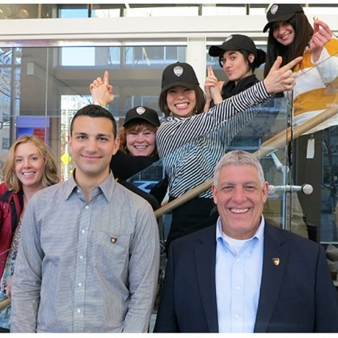
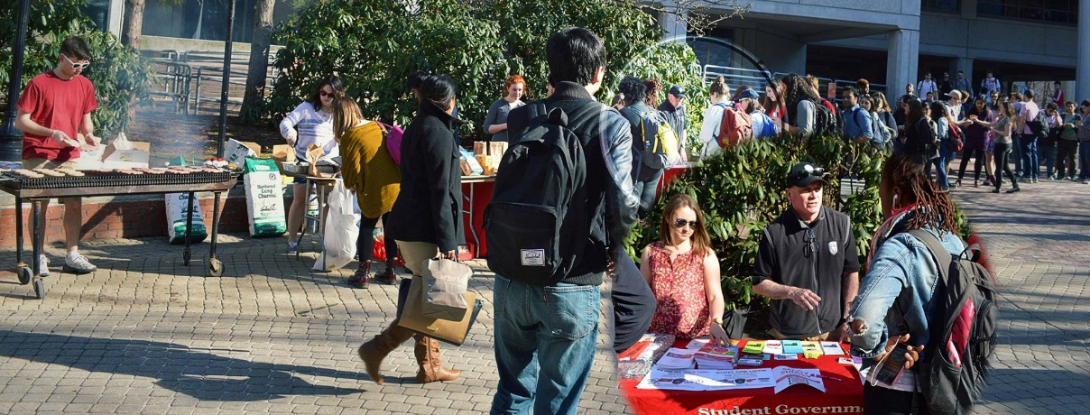
WE must embody the core tenets of procedural justice
Quality of Decision Making
Voice | Neutrality
Quality of Treatment
Respect for People and their rights | Trustworthiness
Notes:
(Anecdote – Photo at Left) Ofc. Bertocci is a Student of Northeastern that was reached during a Co Op Presentation by NUPD. He started as a Co Op Cadet and went to the Academy. He is now an NUPD Officer. Dozens of stories similar to his.
(Other Photos) Exemplify the increased competency for Crime Prevention, Patrol, Satellite Campuses, Outreach, etc.

Slide 22
Intrinsic Value
Language
Treatment
Celebrate
Created Experience

Slide 23
Intentional Engineering Of Trust
Reliability
Sincerity
Competency
The making and keeping of promises
The expressions of genuine concern and interest

Slide 24
Continually Building Partnerships
Provost’s Office
Student Affairs
Facilities
Leadership
Kostas Research Institute
Human Resources
Risk Services

Slide 25
Dimensions of the Approach
To build a culture where everyone believes they can do their best work.
The Approach
Communal Ownership
Activation of Gifts
Innovation
Optimal Efficacy
Collective Competency

Slide 26
What are the Results…
“The officers attending the course are without a doubt some of the most professional officers I have met in 29 years of service.”
“It is comforting to know this University is in all of your hands! Thank you so much again.”
“Thank you, again, for working so diligently and compassionately with [us] during the last few days. We appreciate your support [and] I'm so glad they all had their face-to-face experiences …in Istanbul!”
Sr. Director, Disability Resource Center
Parent of Student Pulled Out of Turkey
Training Officer, Boston PD
“I consider you all my angels.”
NU Student, Following a Medical Emergency
“…[we] had fantastic interactions with NUPD officers...”
“I was blown away by just how quickly you and your teams were able to respond and your presence (some for the majority of your day/evening!) and leadership was essential in our team being able to manage what was an out-of-the-ordinary day for Undergraduate Admissions and our visitors.”
Residential Assistant
“It is therefore with great pleasure that I, In the wake of having my laptop stolen and immediately recovered with the alleged perpetrator caught by your quick thinking and acting professionals, have reason to write to you citing my extreme appreciation of and pride in your officers.”
Professor / Victim
Associate Dean

Slide 27
Policies and Promising Practices
Lieutenant Tarrick McGuire
Arlington Police Department
Arlington, Texas

Slide 28
Policies and Promising Practices
Law enforcement policy on persons with mental illness
Community health and preparedness
Relating preparedness to practice
Procedural justice and outcomes

Slide 29
Procedural Justice, Disability, and Policing
Ariel Simms, J.D.
Criminal Justice Fellow
The Arc’s National Center on Criminal Justice & Disability

Slide 30
Overview
What is disability and developmental disability?
Common misconceptions about disability in policing
Recommendations:
Procedural justice
Crisis prevention
Meaningful inclusion of people with disabilities

Slide 31
Defining Disability
Limits of labels
Models of disability:
Medical model (ADA)
Social model (human rights law)
Notes:
Most people have a general notion of what “disability” means
The word “disability” is a label, one artificially created to describe a group of people with perceived impairments by those without such impairments
Labels can be useful tools and shortcuts in language, and even have legal significance, but it is important to remember that naming something does not necessarily give it meaning
Disability is also not a static concept
It changes over time, means different things to different people, and may have more significance in a particular culture or for a particular community
While there is no universal definition of disability, there are two highly relevant ones:
The social model, which comes from human rights law
And the medical model, which can be found in the Americans with Disabilities Act and many other legal definitions of disability

Slide 32
The Medical Model: ADA
Focus is on the impairment
Limitations, rather than strengths
Also known as the functional limitation model
Actual or perceived impairment
Substantial limitation(s)
Major life activity
Notes:
“Disability” is a very broad term that encompasses a wide range of experiences that impact the way an individual with a disability interacts with the world around them. Both the Americans with Disabilities Act (ADA) and the World Health Organization (WHO) use definitions with these elements:
1. a physical or mental impairment that substantially limits one or more major life activities of such individual;
2. a record of such an impairment; or being regarded as having such an impairment that
3. results in some personal or societal limitations

Slide 33
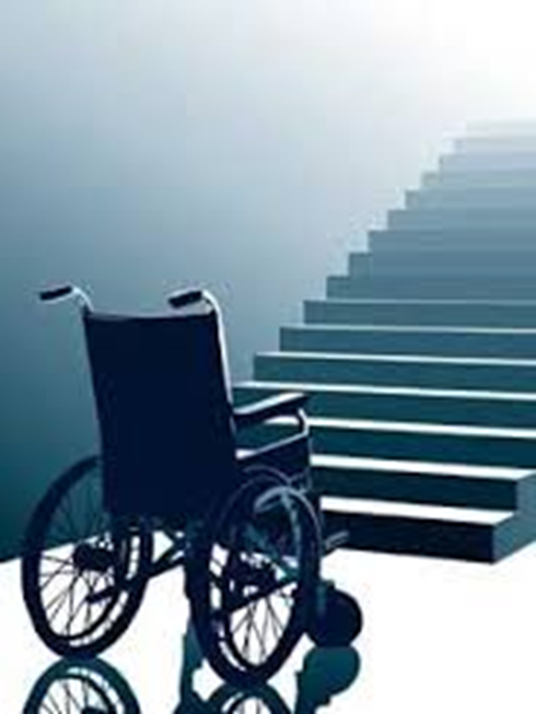
Social Model of Disability
Human diversity
People-first language*
“person with a disability” instead of “disabled person”
Societal barriers
Notes:
The social model of disability, on the other hand, comes from human rights law, which holds that “persons with disabilities include those who have long-term physical, mental, intellectual or sensory impairments, which in interaction with various barriers may hinder their full and effective participation in society on an equal basis with others.”
Under this model, people have disabilities because society creates barriers to equal participation, whether unintentionally or not
Example: wheelchair at base of staircase
Facilitator: Ask training group what they think about the different approaches to disability.
It’s important to ask the person up front how they would like others to refer to their disability or disabilities
Depending on the type of disability a person has, he or she may prefer the use of certain terminology
For example, while many people with I/DD prefer people first language, people in the Deaf or autism community may or may not use people first language

Slide 34
Developmental Disabilities
Physical and/or mental impairments with onset before age 22
Substantial functional limitations in at least 3 of these:
Self-care
Learning
Walking/moving around
Self-direction
Independent living
Economic self-sufficiency
Language
Notes:
Developmental Disabilities are physical and/or mental impairments that begin before age 22, are likely to continue indefinitely, and result in substantial functional limitations in at least three of the following:
Self-care (dressing, bathing, eating, and other daily tasks)
Learning new things
Walking/moving around
Self-direction – making decisions about one’s own life
Independent living
Economic self-sufficiency – working to support oneself
Language
ADD NOTE: lots of labels; want to focus on likely to encounter and most hidden; more data available. ADD a slide with diagnostic labels - Wordle.

Slide 35
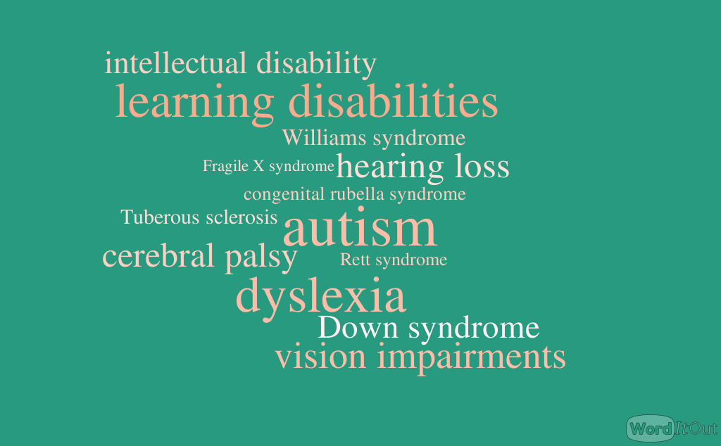
Notes:
Developmental disability is an umbrella term for hundreds of potential diagnostic labels, including the ones you see here
We will focus less on labels and more on the often hidden nature of some of these disabilities, especially autism and intellectual disability
In addition to their hidden nature, some of these disabilities are also very likely to be encountered in the criminal justice system, such as fetal alcohol spectrum disorders (FASD)
Next, we will provide a bit more information about some types of developmental disabilities

Slide 36
Personal Values and Bias
History of discrimination
We are taught to devalue or over-value disability
One way to test our implicit biases:
Implicit Association Test (IAT) – Project Implicit
Notes:
While it may be uncomfortable to talk about, working with people with disabilities requires a careful look at our own value judgments, biases, and stereotypes
Underlying misconceptions about a person’s capabilities and inherent value may hinder efforts by criminal justice professionals to serve, protect, and seek justice for people with disabilities
Each of us carries a set of pre-conceived thoughts or ideas about people unlike us
Admitting these judgments about others is the first step to a respectful and professional relationship with people with disabilities
People with disabilities have faced blatant discrimination for years
For example, Hitler’s Germany began forced sterilizations in 1934 based on diagnoses of “feeblemindedness,” schizophrenia, and epilepsy and by 1939, sterilization morphed into a secret “euthanasia” program carried out in mental asylums and other institutions
The United States perpetuated its own discriminatory agenda in the notorious eugenics movement, in which it was considered acceptable to sterilize those with intellectual disability
This pervasive notion that people with disabilities cannot contribute to humanity persists today in Down syndrome abortion conversations and other genetic screening issues
Regardless of politics, it is important to acknowledge personal feelings about people with disabilities to ensure that those beliefs do not hinder professional obligations and ability to serve and protect all people in society
Bias toward people with disabilities does not have to be negative
For example, some people use people with disabilities as tokens of inspiration – this is quite frequent on social media, where you may encounter memes featuring people with disabilities doing ordinary things (such as working, participating in a sporting event, etc.), yet these people are idolized where people without disabilities would not be
The disability community calls this phenomenon “inspiration porn”
If you are curious about your own tendencies when it comes to under- or over-valuing people with disabilities, check out the Implicit Association Test online.

Slide 37
Misconceptions About Disability in Policing
Disability is rare and easily observable, so officers don’t need training about it
People with disabilities are dangerous
Officers only encounter people with disabilities in “crisis”

Slide 38
Disability Facts
About 15-20% of people worldwide have a disability; a majority of these are “hidden”
People with disabilities are no more dangerous than any other person in the population
People with disabilities:
Are 3-4x more likely to be victims of a crime
Comprise over 40% of the homeless population
Are disproportionately represented in prisons, jails, and every other aspect of the criminal justice system

Slide 39
Recommendations
Implement procedural justice principles into all facets of law enforcement interactions with people with disabilities
Shift from crisis intervention to crisis prevention
Meaningfully include people with disabilities in law enforcement

Slide 40
Recommendation 1: Procedural Justice
Train all officers on disability and how to interact appropriately/with respect
Make use of force policies transparent and review/modify for disability considerations
When force occurs, investigate thoroughly and transparently
Invite members of the disability community to participate in training, policy-making, and in reviewing use of force incidents

Slide 41
Recommendation 2: Crisis Prevention
Train all officers on how to prevent crisis situations for people with and without disabilities
Understand officers’ roles in potentially escalating situations
Differentiate between law enforcement understanding of crisis and disability understanding of crisis

Slide 42
Recommendation 3: Inclusion
Include people with disabilities as trainers for law enforcement officers
Employ people with disabilities as first responders
Consult with the disability community when reviewing policies/procedures

Slide 43
Panel Discussion: Applying Procedural Justice Principles

Slide 44
Applying Procedural Justice
Will examine a few reality-based scenarios, both systemic and individual, and discuss:
How could procedural justice principles to be applied to achieve better outcomes?
How should law enforcement respond differently in these scenarios, using procedural justice principles?

Slide 45
Scenario A
Person with autism is in a public place, engaging in typical autistic behavior. Officer approaches on assumption that the person is high on drugs or has committed some crime.
Outcome: Officer physically restrains the person, causing trauma.
Notes:
Source: https://www.nytimes.com/2017/09/19/opinion/police-autism-understanding.html?action=click&pgtype=Homepage&clickSource=story-heading&module=opinion-c-col-left-region&region=opinion-c-col-left-region&WT.nav=opinion-c-col-left-region&_r=0

Slide 46
Scenario B
Person with a disability is injured or killed in a confrontation with law enforcement.
Outcome: Grand jury/prosecutor does not indict officers on criminal charges, prompting outcry from the community.
Notes:
Source: https://www.washingtonpost.com/local/no-criminal-charges-in-death-of-robert-saylor-frederick-man-with-down-syndrome/2013/03/22/3a723b6c-932f-11e2-8ea1-956c94b6b5b9_story.html?tid=a_inl&utm_term=.c8b14c3e8a45

Slide 47
Scenario C
Officers have little to no training on disability. Officers, like many others in society, hold implicit biases against people with disabilities.
Outcome: Between 1/3 to 1/2 of people killed by police are people with disabilities.
Notes:
Source: https://www.issuelab.org/resource/the-ruderman-white-paper-on-media-coverage-of-law-enforcement-use-of-force-and-disability.html

Slide 48
Participant Q&A
Type your questions for the presenters into the Q&A box on the right-hand side of your WebEx screen.
If we don’t get to your question, email your question to NCCJDinfo@thearc.org and we will follow-up after the webinar.

Slide 49
Thank you for joining us!
Don’t forget to fill out the brief survey that will pop-up after the webinar has ended.

