Slide 1
Paid Family & Medical Leave: The Disability Angle
Webinar
October 23, 2017, 2:00 PM Eastern

Slide 2
Accessibility
For ASL interpreter: Click on “Participants”.
For CART captioning: Click on “Multimedia viewer”.
Adjust the font size in the Header.
To maximize the interpreter and CART windows:
Use “Show/Hide Header” and “Show/Hide Chat” at bottom to hide the header.
Close the “Chat” box.
Make the right-hand panel wider by dragging the panel’s left-hand border to the left.

Slide 3
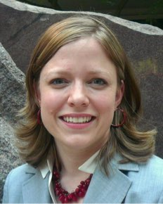
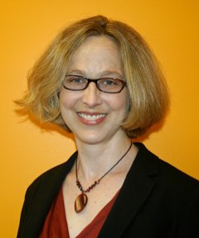
Speakers
Erika Hagensen Disability Policy and Advocacy Consultant The Arc of North Carolina North Carolina Council on Developmental Disabilities | Kali Grant Senior Policy Associate Economic Security & Opportunity Initiative Georgetown Center on Poverty and Inequality | T.J. Sutcliffe Director, Income & Housing Policy The Arc of the U.S. | Lauren Agoratus State Coordinator Family Voices New Jersey

Slide 4
On Twitter
@TheArcUS
@GCPIEconSec
@SPANadvocacy
#PaidLeave
Twitter Logo

Slide 5
What is Paid Family and Medical Leave?
Paid time away from work to:
Address one’s own serious medical condition;
Care for a family member with a serious medical condition; or
Care for a newborn or newly adopted child.

Slide 6
Leave in the U.S.
Family and Medical Leave Act:
12 weeks of unpaid, job-protected leave
40 percent of U.S. workers are not covered
The U.S. has no national paid leave program
States:
3 have programs in place (CA, NJ, RI)
3 have recently passed laws (DC, NY, WA)

Slide 7
U.S. Gaps in Paid Leave
2 in 5 workers have no paid leave
Only 1 in 7 workers has paid family leave
Half of lower income workers did not receive pay during most recent leave
SOURCES: First bullet, Bureau of Labor Statistics, 2012; Second and third bullets, Bureau of Labor Statistics, 2016.

Slide 8
Today’s Webinar
Erika Hagensen: A worker’s perspective
Kali Grant & T.J. Sutcliffe: A new report
Lauren Agoratus: A family’s perspective & advocacy for paid leave in New Jersey
Q & A: Use the “chat” feature to enter your questions during or after the presentations

Slide 9
The unexpected happened
Complicated pregnancy
Extended NICU stay
Ongoing therapies, specialists in two states
Paid leave and workplace flexibility helped my family help me.
(Picture of me as a child in my mom’s arms)

Slide 10
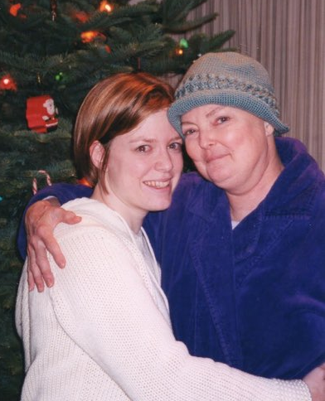
The unexpected happened… again
(Picture of mom 2 years into diagnosis, losing hair)
(Picture of me and my mom, 1 month before she died.)

Slide 11
I became a caregiver in my 20’s
Invasive treatments and surgeries over four years
Declining capacity
Hospice care
Paid leave helped me focus on my mom.
Call HR: implement leave
Meet with Hospice nurse
Review safety and comfort measures
Rent hospital bed, commode, walker, and wheelchair
Pick up prescriptions and meal supplements
*Carry Do Not Resuscitate Order, copy on fridge
Call mom’s closest friends
Organize bedside chats
Create food & med spreadsheet
(Picture of my Hospice care to-do list)

Slide 12
Why we need to be at the table
Impacts every person, family we know
Debunk false narratives
Individuals with disabilities are disproportionately excluded from this benefit
Cross stakeholder collaboration = strength, better policy

Slide 13
Security & Stability:
Paid Family & Medical Leave & its Importance to People with Disabilities & Their Families
Kali Grant, Georgetown Center on Poverty & Inequality
T.J. Sutcliffe, The Arc

Slide 14
Report Overview
Disability & Work in the U.S.
Key Findings
Policy Recommendations

Slide 15
1. Disability & Work in the U.S.
The Demographics of Disability
Economic Outcomes

Slide 16
Demographics
Nearly 1 in 5 has a disability in U.S.
Over 1 in 4 families includes child, adult, or senior with disability

Slide 17
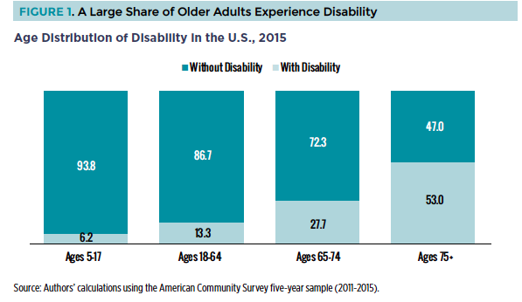
Disability & Age

Slide 18
Disability & Age
People of all ages experience disability
Incidence of disability goes up with age, especially after age 65:
53% of people 75+ face disability, vs. 28% aged 65-74, 13% aged 18-64, 6% aged 5-17

Slide 19
Disability & Race
In 2015, African Americans (19%) & American Indians and Alaska Natives (22%) saw greater incidence of disability than Whites (17%) & Asian American and Pacific Islanders (8%)

Slide 20
1. Disability & Work in the U.S.
The Demographics of Disability
Economic Outcomes

Slide 21
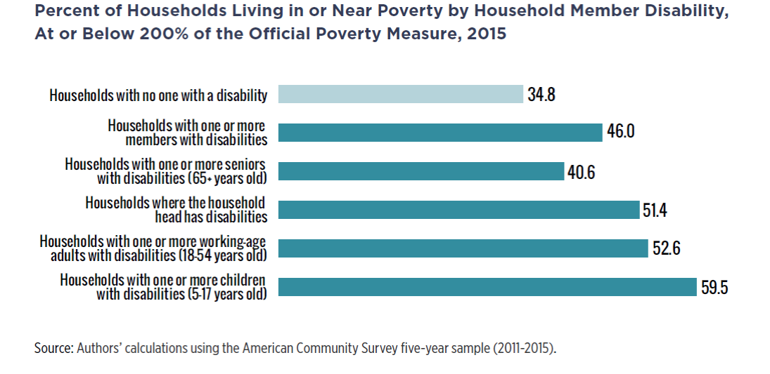
Economic Outcomes

Slide 22
Economic Outcomes
Households with at least one member with disability face higher poverty rates:
35% of households with no one with disability are at or below 200% of the official poverty measure vs. 46% with at least one member with disability

Slide 23
Economic Outcomes & Race
People with disabilities face substantially higher unemployment rates across racial/ethnic groups
African Americans have highest at 17%, followed by Hispanics/Latinos at 12.5%, Asians at 11%

Slide 24
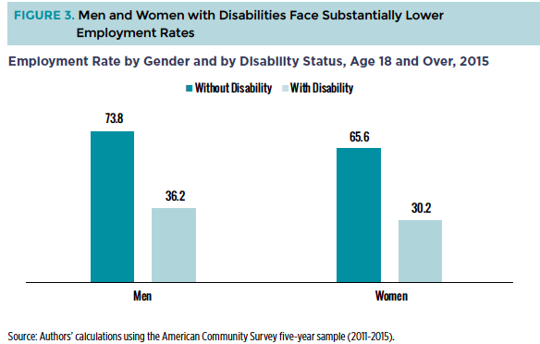
Economic Outcomes & Gender

Slide 25
Economic Outcomes & Gender
People with disabilities face lower employment rates across gender:
Men with disabilities have employment rate of 36% vs. 74% for men without
Women have rates of 30% vs. 66%

Slide 26
Overview
Disability & Work in the U.S.
Key Findings
Policy Recommendations

Slide 27
2. Key Findings
a. Need more comprehensive & modern policies
b. Paid leave helps workers, including people with disabilities & their families, address own/family member’s health

Slide 28
2. Key Findings (Continued)
c. Paid leave boosts employment, economic security & opportunity
d. Access to paid leave is particularly limited for people with disabilities & their families, including extended family members

Slide 29
a. Need More Comprehensive & Modern Policies
U.S. has no national paid leave program, lags far behind peer nations
Over 3 in 4 voters & 7 in 10 small businesses support creating national paid leave program

Slide 30
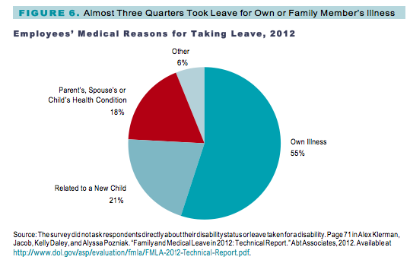
b. Paid Leave Helps Workers Care for Themselves & Family Members

Slide 31
b. Paid Leave Helps Workers Care for Themselves & Family Members (2)
73% of employees’ medical reasons for taking leave was their own/family member’s illness
21% of leave related to new child, while 6% for other reasons

Slide 32
c. Paid Leave Boosts Economic Security & Opportunity
Job-protected paid leave can:
Reduce poverty
Mitigate potential workforce discrimination
Have positive effects on wages, labor force attachment, family well-being, & health

Slide 33
d. Access is Limited for People with Disabilities & their Families
Workers with disabilities’ jobs more likely to be low-wage, part-time (by 30%) &/or lack flexible schedules
Jobs with these characteristics least likely to offer access to paid leave

Slide 34
d. Access is Limited for People with Disabilities & their Families (2)
Gaps persist even in states with own PFML programs
Particularly affect people who are low-income, women, young, LGBTQ, &/or people of color

Slide 35
Overview
Disability & Work in the U.S.
Key Findings
Policy Recommendations

Slide 36
3. Policy Recommendations
A comprehensive, national paid leave program should –
Be accessible to all working people:
Workers at large, medium, and small companies;
Part-time workers; and
Expanded family, including siblings, grandparents, and families of choice.

Slide 37
3. Policy Recommendations (2)
2. Cover all major reasons people need to take leave, including:
Parental, medical, and family leave;
Defined inclusively, such as attending school meetings.
3. Allow intermittent use of leave;

Slide 38
3. Policy Recommendations (3)
4. Replace an adequate percent of wages;
5. Provide sufficient leave duration;
6. Ensure people can keep their jobs and not face negative job consequences;
7. Ensure people can keep their health insurance;

Slide 39
3. Policy Recommendations (4)
8. Include education and outreach that is fully accessible to people with disabilities; and
9. Be cost efficient for workers and employers.

Slide 40
Conclusion
Disability & Work in the U.S.
Key Findings
Policy Recommendations

Slide 41
THANK YOU
Kali Grant
Senior Policy Associate, Georgetown Center on Poverty & Inequality
kag245@georgetown.edu
T.J. Sutcliffe
Director, Income and Housing Policy, The Arc
Sutcliffe@TheArc.org
Sophie Khan
Summer/Fall Fellow, Georgetown Center on Poverty & Inequality
sk1841@georgetown.edu
@GCPIEconSec | @GtownLawPovCntr | www.georgetownpoverty.org

Slide 42
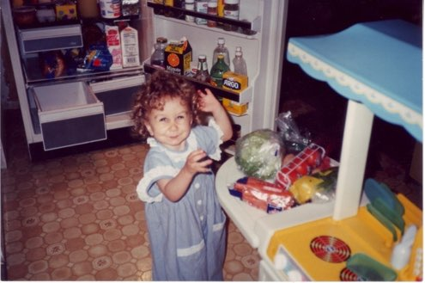
Our Family Story-Agoratus Family
Age-1 year
Unpaid Leave
Lost wages
Medical bills
No previous debt
$20,000 debt
Put mortgage on credit card and almost lost our home

Slide 43
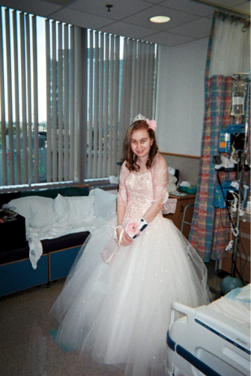
Our Family Story-Redux
Age-19 years
Paid Leave
Mom took ongoing leave for transplant
Dad took intermittent leave for labs/hospital visits (14)
Medical bills mostly covered by Catastrophic Illness in Children Relief Fund
Both paid 2/3 income for time off

Slide 44
Advocating for Paid Leave
NJ Time to Care (NJTC) Coalition (established 2003); members include:
Labor, religious, civic, civil rights, women’s, & disability groups
SPAN & Family Voices NJ
How did NJTC make this happen?
Research on paid leave showed benefits to employees and employers
Poll results showed 78% favored
Fiscal considerations-how to pay?

Slide 45
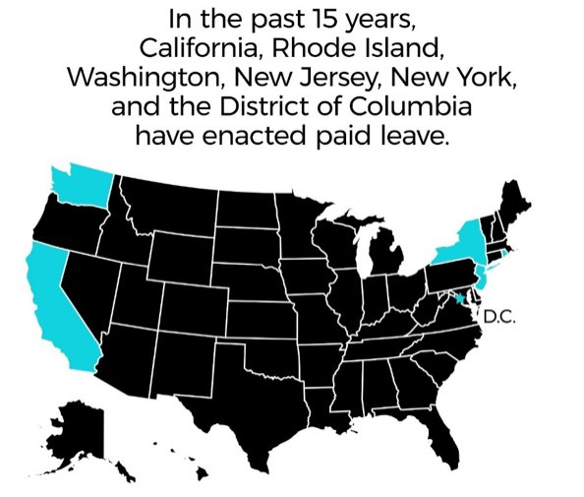
Advocating for Paid leave-continued
Financed paid leave through TDI (temporary disability insurance-small paycheck deduction)
NJ Paid Family Leave Insurance Act introduced 2005
Passed Family Leave Insurance effective July 2009
It didn’t happen overnight but some states have passed paid leave and now there’s a national movement!

Slide 46
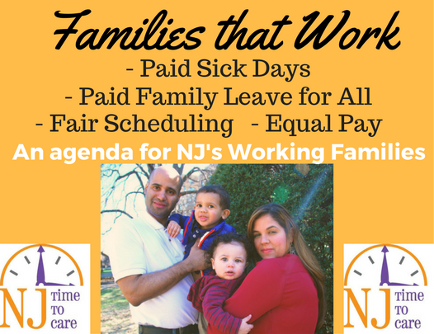
Next Steps
NJTC now working on paid sick days for families and other family support issues
For more information, see www.njtimetocare.org

Slide 47
Q & A
Erika Hagensen Disability Policy and Advocacy Consultant The Arc of North Carolina North Carolina Council on Developmental Disabilities | Kali Grant Senior Policy Associate Economic Security & Opportunity Initiative Georgetown Center on Poverty and Inequality | T.J. Sutcliffe Director, Income & Housing Policy The Arc of the U.S. | Lauren Agoratus State Coordinator Family Voices New Jersey

Slide 48
Get Involved!
The Arc
http://www.thearc.org/paidleave
Georgetown Center on Poverty & Inequality
http://www.georgetownpoverty.org/issues/tax-benefits/pfml/
NJ Statewide Parent Advocacy Network (SPAN)
http://www.spanadvocacy.org/

